Slide 1
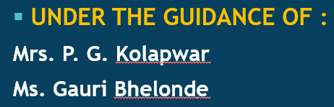
IMAGE STEGANOGRAPHY
A PROJECT BY :
1. Gurudas Chavan (A18)
2. Aakanksha Wadje (A23)
3. Rahul Chafle (A29)
4. Pravin Narwade (A22)

Slide 2
CONTENTS
Abstract
Introduction
Project Plan
Implementation
Modules Used
Conclusion & Future Scope

Slide 3
ABSTRACT
Image steganography is a GUI-based project in which we are hiding a secret message within the image using encoding and decoding functions. We are creating a window in which there are two buttons: encoding and decoding.
For encoding, select any image, this image. Type message in the message box then it will convert into base64, merge this encoded string into image and the user can save the image where user wants.
For decoding, select the image which is encoded, the base64 string will get separated by decoding, and by Tkinter module hidden text is shown in the textbox.

Slide 4
INTRODUCTION
Steganography is the process of hiding a secret message which is text-based data within non-text files like image file, audio, video file etc. In such a way someone cannot know the presence of a hidden message in a particular file.
The main purpose of Steganography is to maintain secret communication between two people. It generally refers to encoding and decoding.
The objective of this is to hide the message within the image and then decode the image. It uses Tkinter, Stegano modules. Functions in Python will also be used.

Slide 5
PROJECT PLAN
This project requires good knowledge of python and the Tkinter library. Tkinter is the python binding to the Tk toolkit which is used across many programming languages for building the Graphical user interface which is a GUI.
Also, we require a PIL module. This is the images module from the pillow. The PIL module helps to open, manipulate and save many different forms of images.

Slide 6
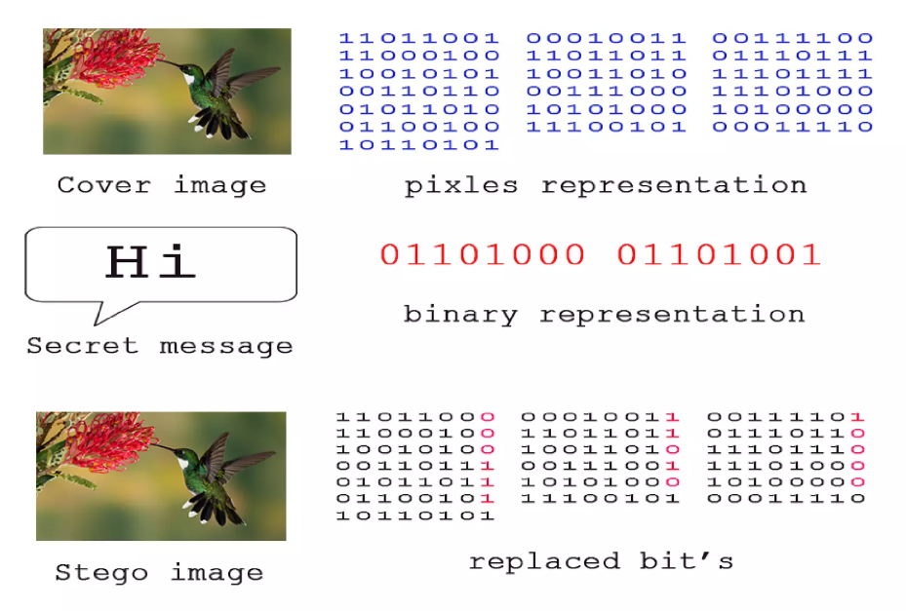
IMPLEMENTATION
v

Slide 7






The most common methods to make this project involve the usage of the least-significant bit or LSB, masking, filtering and transformations on the over image.
Dear Son,
I can wait no longer I want to see you now please say that you will come.

Slide 8
MODULES USED
Basic knowledge of Tkinter and Stegano is required. Knowledge of functions in Python is also a must for this project.
Tkinter module
PIL module
Stegano module
GUI Loop
Functions to encoding and decoding the images
Import os etc.

Slide 9
CONCLUSION & FUTURE SCOPE
Picture steganography has been utilized covertly data transmission with the goal that data can be transmitted in secure and mystery way. Based on picture steganography process mystery data has been converted into parallel arrangement and that has been installed with pixels bits of the cover picture.
In the near future, the most important use of steganographic techniques will probably be lying in the field of digital watermarking.
Content providers are eager to protect their copyrighted works against
illegal distribution and digital watermarks provide a way of tracking
the owners of these materials.

Slide 10


